Slide 1

Cardinality Estimation: A Comprehensive Look
Kate Smith
Senior PM, Microsoft SQL Server
She/Her

Slide 2
More Historical Perspective
A bit about CE History…

Slide 3
So…What are these models anyway?
Pre-2012 CE
2012 and later CE
CE Feedback changes all of this by diverging
from the one-size-fits-all model.
Uniformity
Independence
Containment
Uniformity
Partial independence
A different take on containment

Slide 4
Uniformity

Slide 5

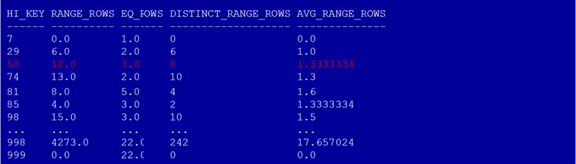
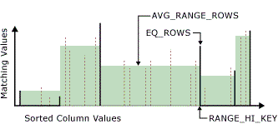
Statistics: Building Blocks of CE
Histogram
RANGE_HI_KEY
EQ_ROWS
RANGE_ROWS
DISTINCT_RANGE_ROWS
Notes:
Introduce terminologies:
Frequency: # of occurrence for each distinct value in a data set
Density: 1 / distinct values

Slide 6
Uniformity Assumption
Distinct values are evenly spaced and that they all have the same frequency.
More precisely, within each histogram step:
Distinct values are evenly spread
Each value has same frequency
Notes:
The Model:
Our assumption on how well-behaved data should look at.

Slide 7
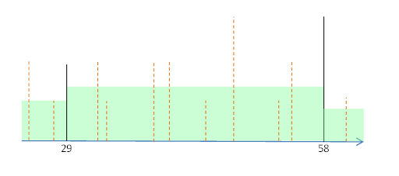
Uniformity in action
Estimate selectivity of column-equal-constant predicate
Select * from T where T.c1 = 50
Value 50 exists in the histogram bucket (containment)
Frequency of value 50 is the average frequency in the bucket (uniformity)
50

Slide 8
CE Feedback, Uniformity, and Row Goal
Row goal can apply to queries of type select TOP n * \ FAST n \ IN \ EXISTS
QO calculates the number of rows to be read to find the required “TOP n” rows
Is there a large % of rows matching the query predicate?
If so, scanning a few pages might be enough to produce the required rows
But if the data is not uniformly distributed, SQL might scan more pages than estimated = row goal was inefficient
CE Feedback can disable the row goal scan and enable a seek

Slide 9
CE Feedback Demo: Row Goal

Slide 10
Independence

Slide 11
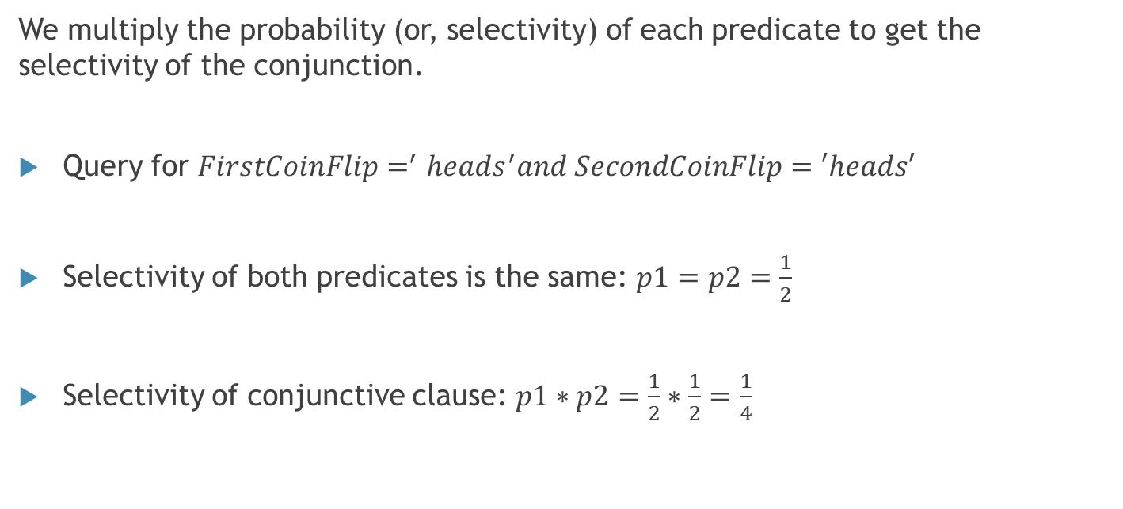
Independence
We multiply the probability (or, selectivity) of each predicate to get the selectivity of the conjunction.
Query for $FirstCoinFlip=^{′}heads^{′}and SecondCoinFlip=′heads′$
Selectivity of both predicates is the same: $p1=p2=\frac{1}{2}$
Selectivity of conjunctive clause: $p1∗p2=\frac{1}{2}∗\frac{1}{2}=\frac{1}{4}$

Slide 12
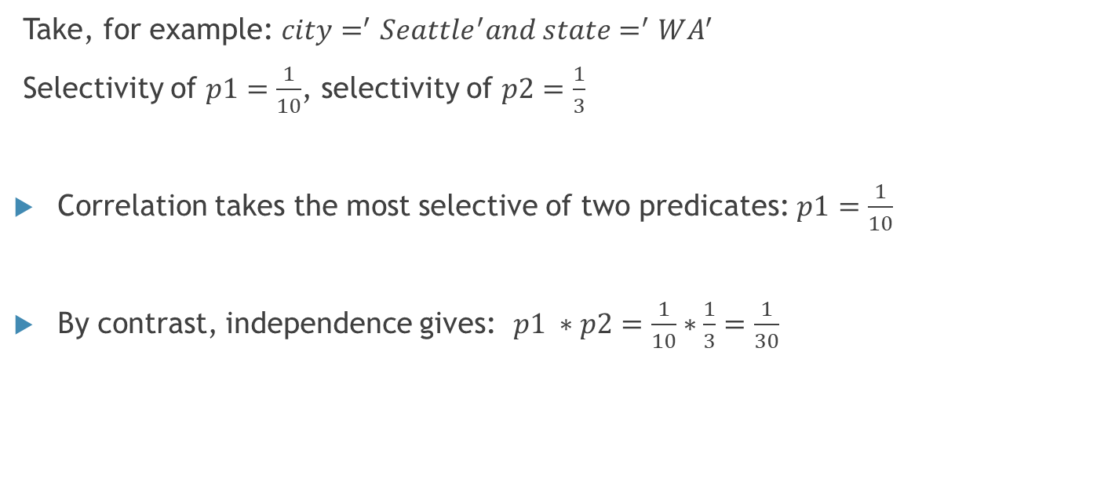
Correlation
Take, for example: $city=^{′}Seattle^{′}and state=^{′}WA^{′}$
Selectivity of $p1=\frac{1}{10}$, selectivity of $p2=\frac{1}{3}$
Correlation takes the most selective of two predicates: $p1=\frac{1}{10}$
By contrast, independence gives: $p1 ∗p2=\frac{1}{10}∗\frac{1}{3}=\frac{1}{30}$

Slide 13
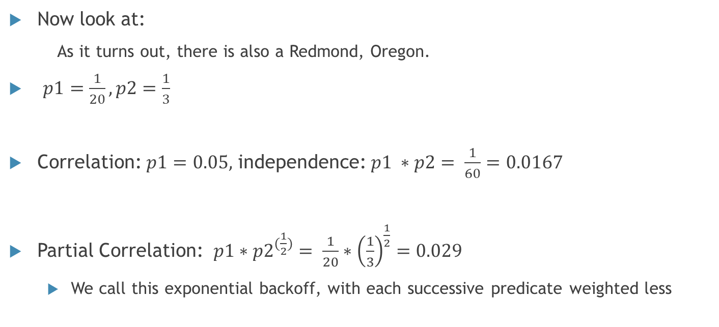

Partial correlation
Now look at:
As it turns out, there is also a Redmond, Oregon.
$p1=\frac{1}{20},p2=\frac{1}{3}$
Correlation: $p1=0.05,$ independence: $p1 ∗p2= \frac{1}{60}=0.0167$
Partial Correlation: $p1∗p2^{(\frac{1}{2})}= \frac{1}{20}∗{\left(\frac{1}{3}\right)}^{\frac{1}{2}}=0.029$
We call this exponential backoff, with each successive predicate weighted less
$$City=^{′}Redmond^{′}and State=^{′}WA′$$

Slide 14
CE Feedback
Independence
Full correlation
Partial correlation

Slide 15
CE Feedback Demo: Independence

Slide 16
Containment

Slide 17
Containment means a few things
Basic idea: If you query it, it is there.
Used when probing histograms with equality predicates.
Also used in joins. There are two different approaches:
Base Containment
Simple Containment

Slide 18
Containment
Simple Containment
Assumes joins are fully correlated
Estimate join selectivity based on the input relations only – using the already scaled-up or down estimates of any non-join filter predicates on the joined tables
Summary: first estimate filters and then join
Base Containment
Summary: first estimate join and then filters

Slide 19

Base Containment
$$\begin{matrix} & & \left(L.receipt_no=R.receipt_no\right) & & \\ & & ⋈ & & \\ & / & & \backslash & \\ \begin{aligned}σ \\ (item_{type}=′toy^{′})\end{aligned} & & & & \begin{aligned}σ \\ (return_{date}=′2013−1{−1}^{′})\end{aligned} \\ | & & & & | \\ Store_Sales & & & & Store_Returns\end{matrix}$$
Assumes no correlation between join predicates and downstream filters (including downstream joins).
Estimate join selectivity based on the base table properties before applying the selectivity of non-join filters
$receipt_no$from $Store_Returns$exist in $Store_Sales$

Slide 20

Simple Containment
$$\begin{matrix} & & \left(L.receipt_no=R.receipt_no\right) & & \\ & & ⋈ & & \\ & / & & \backslash & \\ \begin{aligned}σ \\ (item_{type}=′toy^{′})\end{aligned} & & & & \begin{aligned}σ \\ (return_{date}=′2013−1{−1}^{′})\end{aligned} \\ | & & & & | \\ Store_Sales & & & & Store_Returns\end{matrix}$$
Assumes joins are fully correlated
Estimate join selectivity based on the input relations only – using the already scaled-up or down estimates of any non-join filter predicates on the joined tables
The items returned on 2013/1/1 are all toys, which is an unreasonable assumption to make for this query!

Slide 21
CE Feedback
Containment adjustments apply to joins only, and only if there are non-join filters below the join
If incoming join-input estimates are acceptable, and outgoing estimates bad, it is likely containment model related
If it’s determined that containment is at fault, simply recommend the opposite containment model

Slide 22
CE Feedback Demo: Containment

Slide 23
In Summary…
Historically, CE used a “one-size-fits-all” approach called the “Model”
Various models/model variations have been tried over time
CE Feedback dynamically adjusts between models on a per-query basis in a do-no-harm way.
By using query store hints, feedback persists and requires no code change

Slide 24
Thanks!

